Slide 1

LEADING DECISIVELY!
LEADING FAITHFULLY!
Shaping
Servant Leaders
E. LeBron Fairbanks
Africa Region, South and South Central Fields
August 16, 2025

Slide 2
Course Purpose
This webinar
seeks to encourage each participate
to a lifelong pursuit
of Christian formation and Christian maturity,
as we increasingly understand and embrace
the unique relationship
between the theology and faith we profess
and the way we LIVE and LEAD.
(See 2 Corinthians 3:16 -18)

Slide 3
PLEASE SHARE IN CHAT OR ON-LINE
BIG INSIGHT?
KEY THEME?
“A-HA” MOMENT?
MOST HELPFUL VISUAL/GRAPH/TEMPLATE?
IMMEDIATE “TAKEAWAY”?
COMMENTS?

Slide 4
Webinar Sub-Themes
The PASSION of servant leaders ….
The LIFESTYLE of servant leaders ….
The GOAL of servant leaders ….
The METHODS of servant leaders....
The VISION and PAIN of servant leaders….
The EVIDENCE of servant leaders ….

Slide 5

Session 1:
The
PASSION of
Servant
Leaders

Slide 6
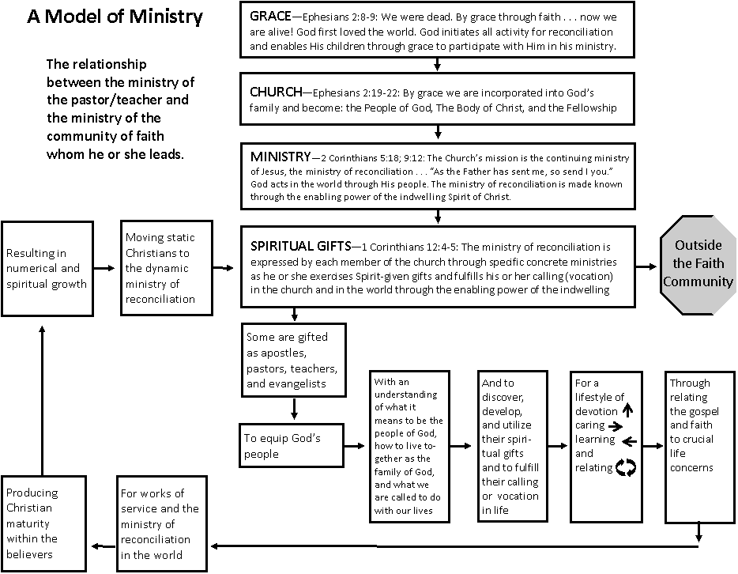

Slide 7
Seven expressions of the Ministry of Every Believer:
The Ministry … of Holding One’s Tongue
… of Meekness
… of Listening
… of Active Helpfulness
… of Bearing Another’s Burdens
… of Proclaiming the Word of God
… of Authority
From Life Together – Dietrich Bonheoffer

Slide 8
Christian Leadership…
is humble service to others,
for the purpose of enabling them,
through teaching and example,
to live their lives
under the Lordship of Christ,
and to understand, accept, and fulfill
their ministry to others
and their mission to the world.
E. LeBron Fairbanks

Slide 9
Session 2:
The
LIFESTYLE of
Servant
Leaders

Slide 10
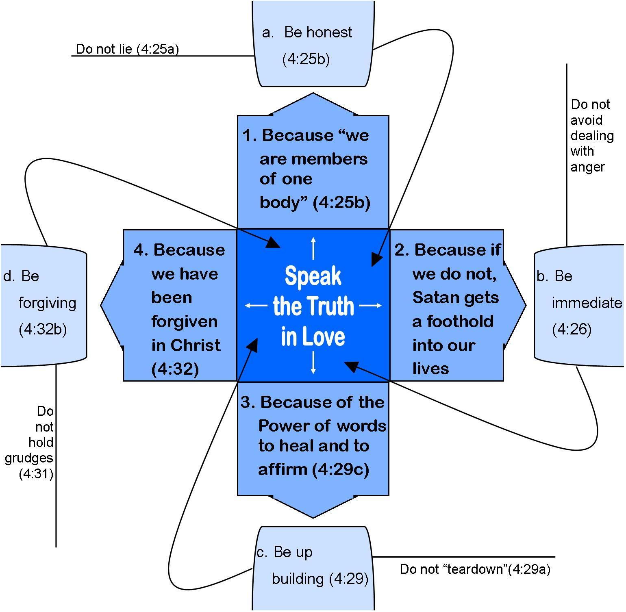
A Communication Model for Leading the People of God
Ephesians 4:1-5:2
4:26
(4:27)

Slide 11
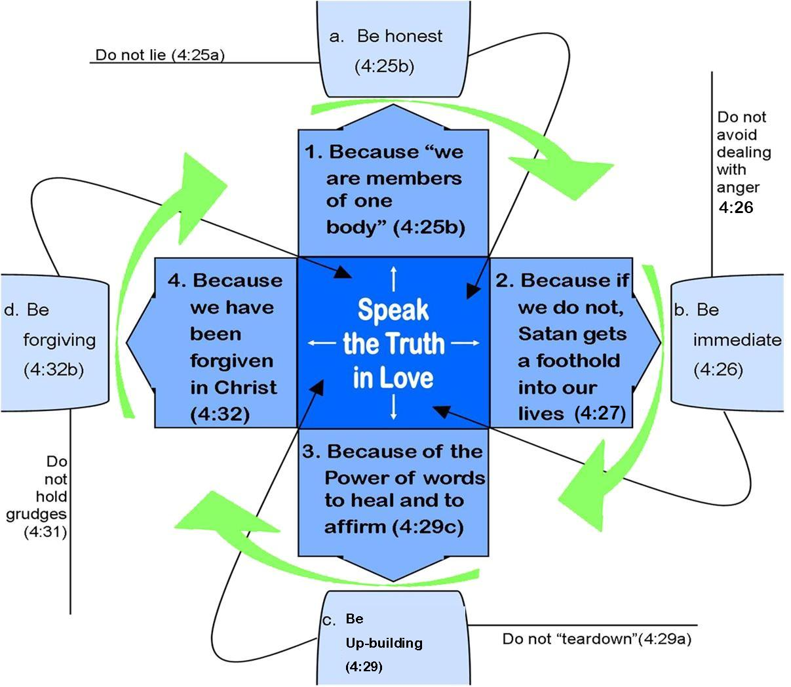

Slide 12
leadership Insights:
The Spirit of God is deeply concerned with the speech of His people (Ephesians 4:29-31).
The spiritual life of the leader is the key to
“reconciliation” when good and godly
people collide within a Christian community
(Ephesians 4:1-3, 25).

Slide 13
_{Session 3:}
The
GOAL of
Servant
Leaders

Slide 14
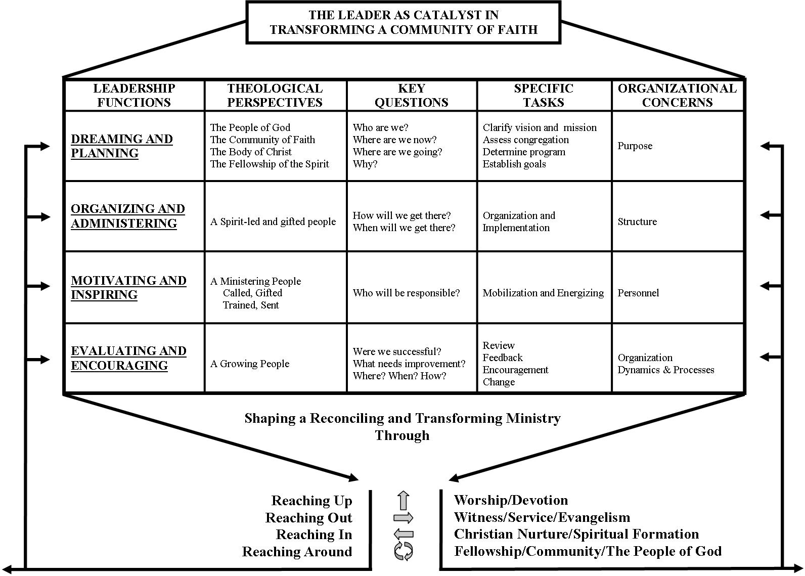

Slide 15
Leadership for
Congregational Transformation…
…involves equipping the
people of God for ministry and mission.
… includes defining, clarifying
and preparing each disciple
for her or his
Spirit-empowered ministry.

Slide 16
Transformational leadership:
Ephesians 4:11-16
The context of congregational transformation is “God’s People” or “ministry participation.” (Ephesians 4:11).
The task in congregational transformation is to “prepare God’s people” or “ministry formation.” (Ephesians 4:12)
“The Ministry of Every Christian is to Serve Others in Jesus Name”

Slide 17
The goal of congregational transformation is “works of service” or “ministry expression.” (Ephesians 4:12).
The dynamic of congregational transformation is “love within the body of Christ” or “ministry interaction.” (Ephesians 4:15-16).
The purpose of congregational transformation is a “holiness lifestyle” or Christ-like ministry.” (Ephesians 4:13).
“The Ministry of Every Christian is Serving Others in Jesus Name”

Slide 18
Session 4:
METHODS of
Servant
Leaders

Slide 19
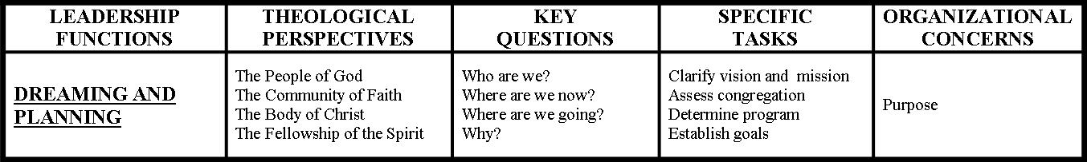
THE LEADER AS CATALYST IN
TRANSFORMING A COMMUNITY OF FAITH
Dreaming and Planning

Slide 20
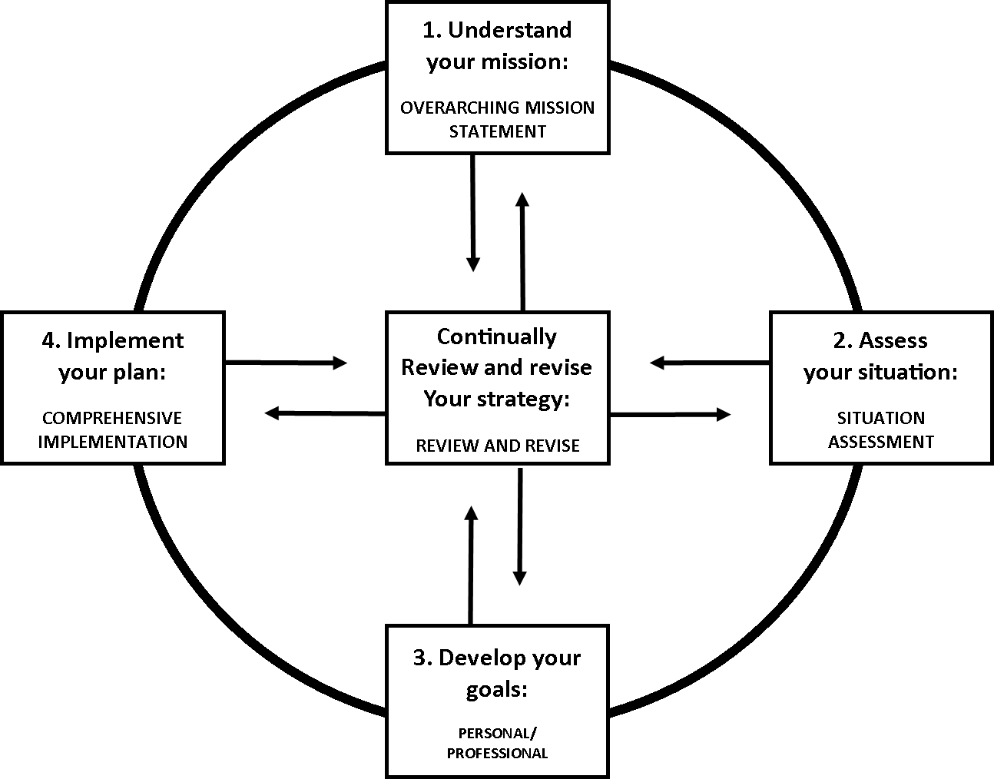
Planning
Cycle
1. Understand
Your mission:
OVERARCHING MISSION STATEMENT
4. Implement your plan:
COMPREHENSIVE
IMPLEMENTATION
Continually
review and revise
your strategy:
REVIEW AND REVISE
2. Assess your situation:
SITUATION
ASSESSMENT
3. Develop your goals:
PERSONAL/
PROFESSIONAL
Notes:
Refer to LD! LF! text. Appendix C. "Missional Planning Template," pp 241 - 242.
Refer to LD! LF text. Appendix D. "Local Church Board Diagnostic," pp 243 - 245.

Slide 21
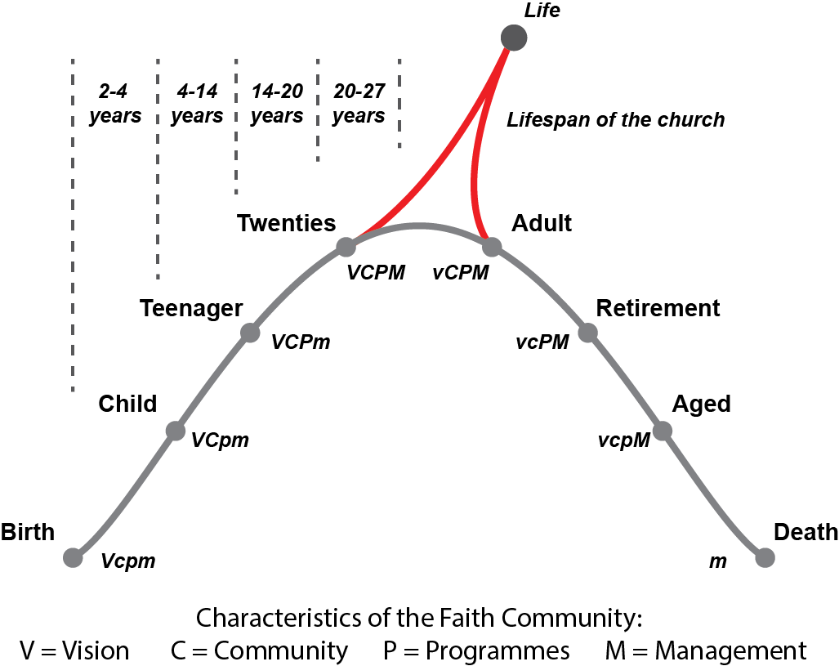
Life Stages of a Local Church
Notes:
LIFE STAGES OF A LOCAL CHURCH
CHARACTERISTICS OF A FAITH COMMUNITY: VISION
COMMUNITY
PROGRAMS
MANAGEMENT
THE MOST CRITICAL POINT IN THE LIFE CYCLE….!

Slide 22
ESTABLISH GROWTH GOALS
Growth goals are statements of faith for the
Christian leader and local church that express clearly
what we believe God will do through us.
A GOAL should be:
1. Be measurable.
2. Be feasible
3. Be attainable.
4. Contain an action verb.
5. Have a deadline.

Slide 23
Encouraging the Heart
The First Essential: Set clear Standards
The Second Essential: Expect the Best
The Third Essential: Pay Attention
The Fourth Essential: Personalize Recognition
The Fifth Essential: Tell the Story
The Sixth Essential: Celebrate Together
The Seventh Essential: Set the Example
James Kouzes and Barry Posner

Slide 24
Session 5:
METHODS of
Servant
Leaders

Slide 25
Mentoring
(See LD! LF! Pages 88-94)
Basic Mentoring Questions
What are your dreams?
What are your priorities?
What keeps you awake at night?
How are you doing, personally?
How are you progressing in
your ministry assignment?
6. How can I help?

Slide 26
Strong and Effective
Governing Boards
(See LD! LF! Pages 95 – 108)
See also LD! LF! Appendix B
“Characteristics of
Strong and Effective Boards”
Pages 239-240

Slide 27
Strong boards
EMPOWER
Missional and Visional Pastors
___
Strong leaders
EMBRACE
passionate and engaged boards

Slide 28
Characteristic #3
Board members
ask the
right questions

Slide 29

Strategic Questions
(value defining and forward thinking…)
Who are we?
Where are we?
Where are we going?
How will we get there?
Why is it important to get there?
How will we know when we get there?

Slide 30
A Key Question
“Always, the key question to be asked in Board decision making is:
Is this decision important for the long-term survival, health, and mission achievement of our church?
After answering this question, then policies and decisions can be made.”
Albert J. Meyer, author. p. 217

Slide 31
Board Development Questions
LD! LF! Appendix D. “Local Church Board Diagnostic” Pages 243 – 245
A LEGAL AND PROGRAM AUDIT TEMPLATE (Modify as needed and appropriate)
LD! LF! Appendix E. “Board Evaluation Survey” Pages 246 – 250
A. Board and Mission
B. Board/Pastor Relations
C. Member to Member Relations
D. The Board Agenda
E. The Organization of the Board
F. The Functioning of the Board
G. Additional Important Questions
H. Summary Questions
Major Strengths of our Board…
Three Board Development issues we
focus on during the next 18 months:

Slide 32
Session 5:
The
VISION
& PAIN of
Servant
Leaders

Slide 33

Vision

Slide 34
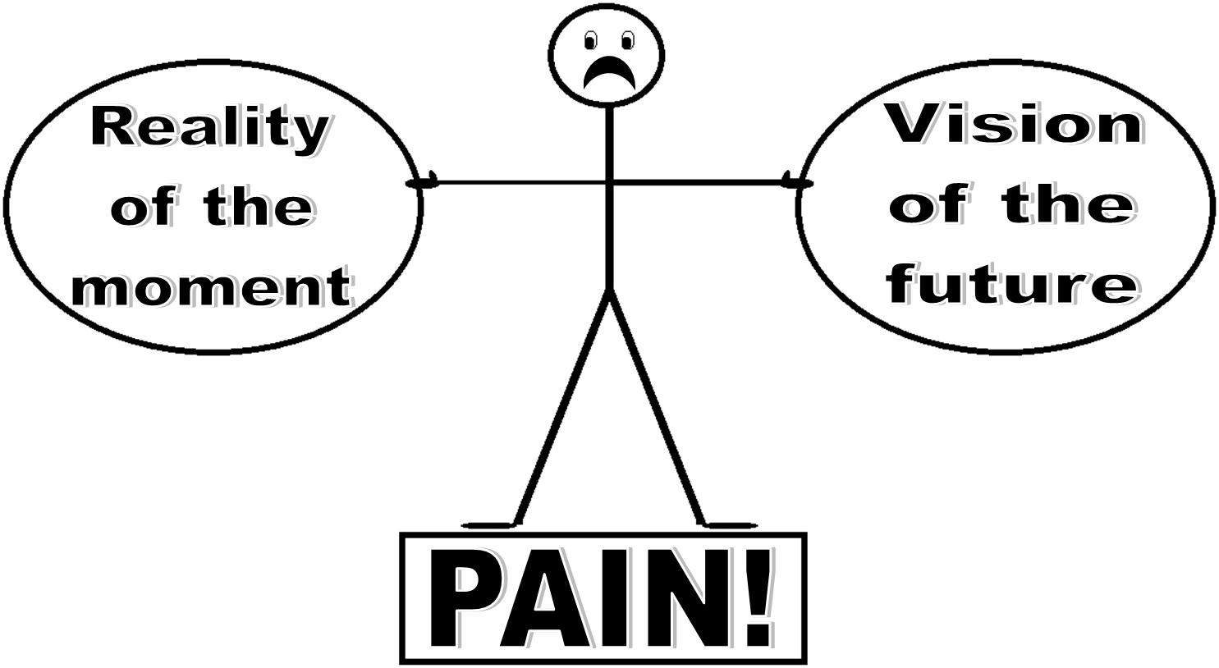

Slide 35

Reality
Vision

Slide 36
Vision
Reality

Slide 38
Good and godly people
often differ
(and sometimes collide)
on how to reach
mutually desired goals

Slide 39
Is it possible
to live and work
together as Christians
so that our relationships
are redemptive and a witness
to unbelievers?

Slide 40
Seven “anchors” that hold us steady as Christian leaders

Slide 41
Anchor #1:
“Speak Gracefully”
Our words
can be channels
of God’s grace to others
Ephesians 4:29

Slide 42
Do Our Words?
Encourage or discourage
Uplift or “putdown”
Speak positively or negatively
Reflect cultural sensitivity or
cultural “blindness”
Focus on the other person, or
focus on self

Slide 43
How do others feel when they leave our presence?
Stronger or weaker?
Larger of smaller about themselves?
Confident or hesitant?
Understood or misunderstood?
Affirmed or manipulate?
Blessed or “destroyed”?

Slide 44
COMPLEMENT to CRITICISM Ratio
Reality in
Troubled Families:
2-3 / 7-8
Goal in
Healthy Families:
7-8 / 2-3

Slide 45
Anchor #2:
“Live Gratefully”
Give thanks in all circumstances,
for this is God's will
for you in Christ Jesus.
I Thessalonians 5:18

Slide 46
We can feel good about ourselves until we compare ourselves
with the gifts, talents, and abilities
of other people…
families, pastors or leaders,
or other churches!
Our Response?

Slide 47
Anchor #3:
“Listen Intently”
…be quick to listen,
slow to speak,
and slow to get angry.
James 1:19
Listen for more than words . . .

Slide 48
Theological vision
must precede
organizational vision

Slide 49


Two ways of Thinking and Reacting
Growth Producing
Growth Inhibiting

Slide 50
Growth producing questions
What can I learn?
How can I change?
Growth inhibiting questions
Why me?
What if …?

Slide 51
Anchor #4:
“Forgive Freely”
Jesus said,
"Father, forgive them,
for they do not know
what they are doing.”
Luke 23:34

Slide 52
Anchor #5:
“Lead Decisively”
In a spirit of humility
and brokenness,
we move ahead
cf. Philippians 2:5-11

Slide 53
It is in the tension between
our vision for the future
and the reality of the present
that our decision-making as leaders
most often takes place!

Slide 54
We move ahead
decisively through
Prayer . . .
Collaboration . . .
Gratitude . . .

Slide 55
In this spirit
of humility
and brokenness,
we move ahead

Slide 56
Leading decisively
with Christian humility
requires these skills
Listening and communicating
Timing and processing
Affirming and encouraging Asking and inquiring
Discernment and delegation

Slide 57
Anchor #6:
“Care Deeply”
Caring Christians
Value People,
Not Power
cf. 2 Thessalonians 2:1-6

Slide 58
The final Anchor is this:
“Pray Earnestly”
Pray, believing
that God can work in ME
to become the change
I desire to see in OTHERS
I Thessalonians 5:17
Matthew 7:1-5

Slide 59
MY LEADERSHIP CREDO*
Live Gratefully. Don’t complain. Be grateful.
Speak Gracefully. Watch the words I speak.
3. Listen Intently. Seek First to Understand.
4. Forgive Freely. A Spirit of forgiveness transforms and empowers leaders.
5. Lead Decisively. Combine clear vision, deep humility, and intense resolve.
6. Love Deeply. Value People, not Power.
7. Pray Earnestly. Become the change that I seek in others.
*Adapted from my book, “Mentoring and Modeling Leadership Character”, Chapter Four, pages 54-55.

Slide 60
Session 7:
The
EVIDENCE of
Servant
Leaders

Slide 61
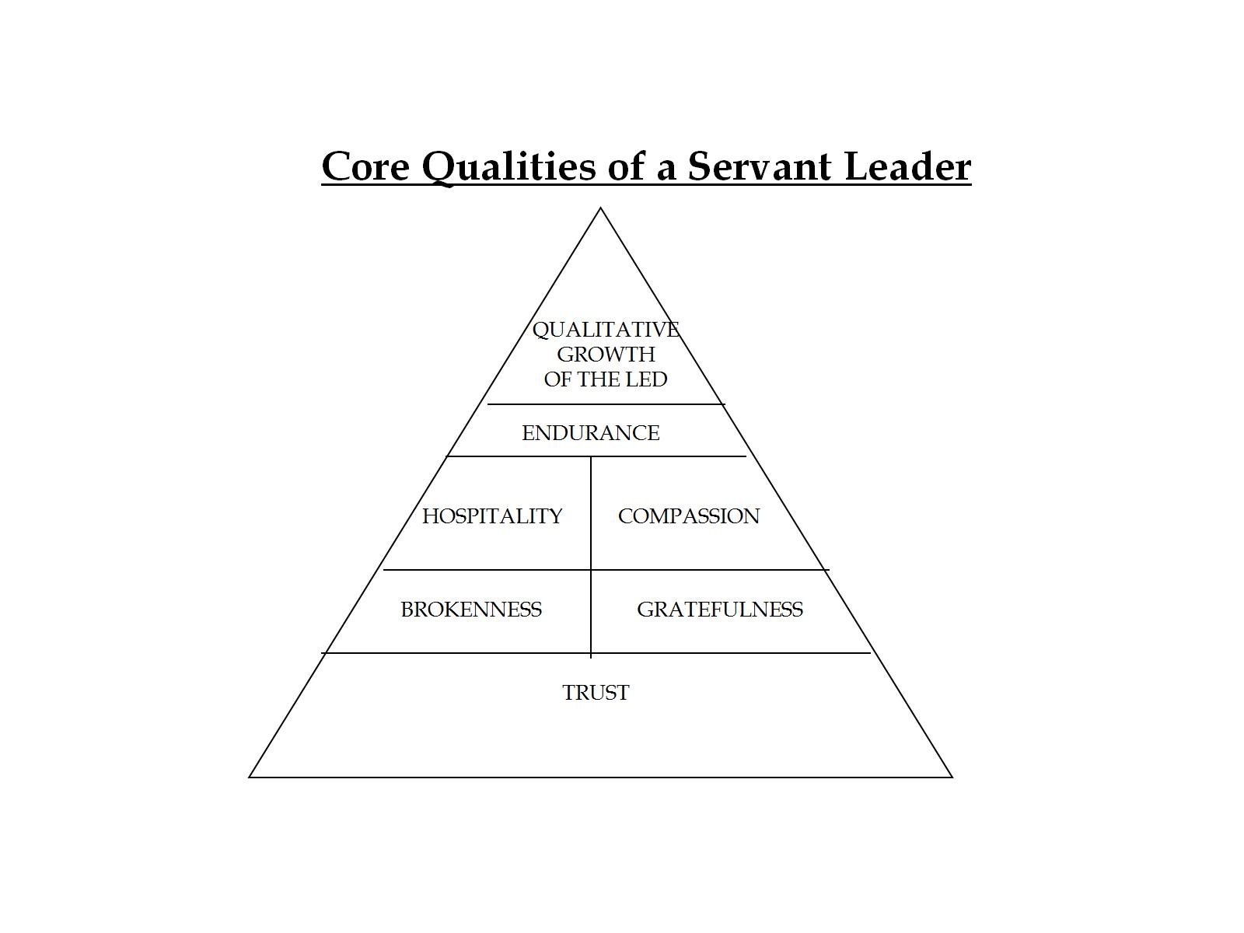

Slide 62
SPIRIT-EMPOWERED,
TRUST-DEVELOPING
RELATIONAL PRACTICES
OF A LEADER
WHO ‘SHOWS UP’,
AND IS ‘PRESENT’
IN THE MOMENT

Slide 63
The Relational Practice of Consistency and Integrity
“Do I live the way I say I live … consistently?”
“Do I do what I say I will do … consistently?”
Christian leader when asked,
“how do you want to be remembered,” replied,
“… as man of integrity.… a consistency between my public and private life. A complete person.”

Slide 64
Consistency and Integrity
Myanmar pastor:
“…leading others
begins with leading myself.”

Slide 65
Self-evaluation questions
regarding Consistency and Integrity
Is my behavior predictable or erratic?
2. Do I communicate clearly or carelessly?
3. Do I treat promises seriously or lightly?
4. Am I honest or dishonest?
5. Do I keep conversations confidential
or do I “gossip”?
6. Why do people I lead trust or distrust me?

Slide 66
INTEGRITY ?
HONESTY, CONSISTENCY
The same inside and outside.
It is the #1 trait people want in leaders
From a biblical viewpoint…
to live in light of what is important to God
To live our lives consistent
with what we profess by faith

Slide 67
Questions in pursuit of Integrity
Is this action I am considering strengthen me spiritually?
2. Would I want my son, my wife, or my best friend
to copy this action of mine?
3. Does this action violate a biblical principle?
4. Does this action strengthen the body of Christ?
5. Would an unbelieving friend be attracted to Christ
and the Christian faith by my behavior?

Slide 68
“ Many people claim to be loyal, but it is hard to find
a trustworthy person.”
Proverbs 20:6 (NCV)
How can we lead in such a way
that those we lead say,
“I deeply trust you?”
In the homes, small groups/faith communities,
local congregations,
and ministry organizations
we lead?

Slide 69

The way we
preach on Sunday,
live in the home,
work in the community,
and lead a board meeting
should give evidence to an increasing
“conformity to the mind of Christ”
(II Corinthians 3:18),
and a nurturing of trust in us
by those we lead!

Slide 70
Session 8:
Review,
Share, &
Comment

Slide 71
SESSION Sub-THEMES
The PASSION of servant leaders ….
The LIFESTYLE of servant leaders….
The GOAL of servant leaders….
The METHOD of servant leaders….
The VISON AND PAIN of servant leaders….
The EVIDENCE of servant leaders….

Slide 72
PLEASE SHARE IN CHAT OR ON-LINE
BIG INSIGHT?
KEY THEME?
“A-HA” MOMENT?
MOST HELPFUL VISUAL/GRAPH/TEMPLATE?
IMMEDIATE “TAKEAWAY”?
COMMENTS?

Slide 73
Prepared for BoardServe LLC
Edward LeBron Fairbanks
lfairbanks@boardserve.org
BoardServe.org
Fairbanks Digital Collection: https://mvnu.whdl.org/en/browse/collections/14284
Presented in Zoom Webinar
Church of the Nazarene - Africa Region
Southern Africa Hub Leaders
August 16, 2025

