Slide 1



Slide 2

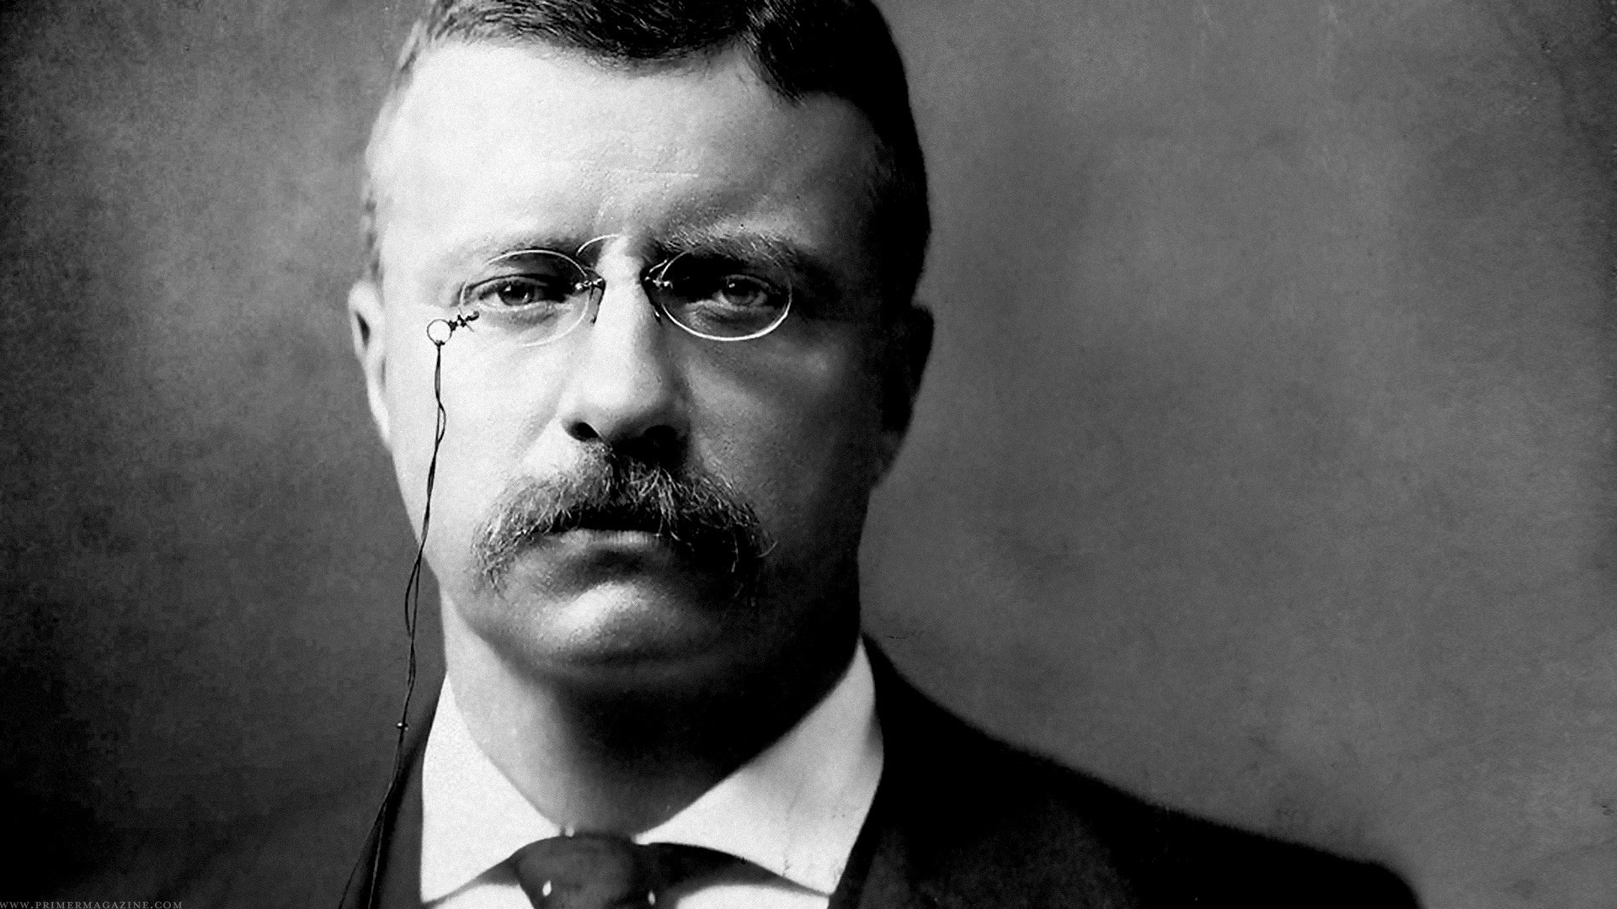
"It is not the critic who counts; not the man who points out how the strong man stumbles, or where the doer of deeds could have done them better. The credit belongs to the man who is actually in the arena, whose face is marred by dust and sweat and blood; who strives valiantly; ...who spends himself in a worthy cause; who at the best knows in the end the triumph of high achievement, and who at the worst, if he fails, at least fails while daring greatly, so that his place shall never be with those cold and timid souls who neither know victory
nor defeat."
- Theodore Roosevelt, April 23, 1910

Slide 3


Strong boards empower missional and visionary leaders, and strong leaders embrace passionate and engaged boards.

Slide 4

Five "Non-negotiables” for
Board Health and
Fund Development

Slide 5
Five Non-negotiables...!
1. Know the Basics:
2. Ask the ‘Right’ questions:
3. Communicate in conflict situations with civility:
4. Embrace assessment of prior board decisions:
5. Connect board decision-making to capacity building:

Slide 6

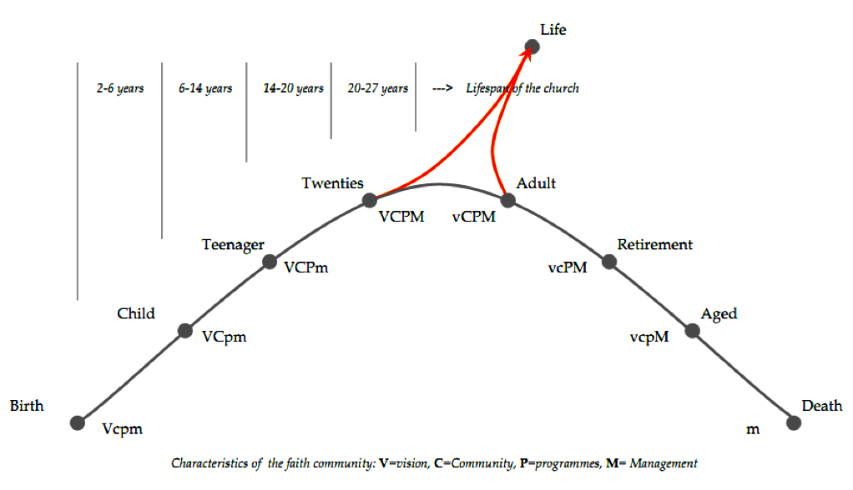
Lifespan and Stages of a faith community
New Life

Slide 7

Organizations evolve and change. So must their governing boards.

Slide 8
1
Non-negotiable
KNOW THE BASICS:
UNDERSTAND THE ESSENTIALS OF THE
BOARD’S ROLE, PURPOSE, AND FUNCTION
”HEADS IN; FINGERS OUT!”

Slide 9
A governing board …
1. oversees the mission,
2. develops a shared vision, and
3. shapes the future of the organization.
Responsibility #1:
Select the best executive director possible
for the organization.
Responsibility #2:
Ensure Accountability...
to the government; to moral owners;
and for the leader(s).

Slide 10
Four modes of thinking
about Board Governance
FIDUCIARY
STRATEGIC
REPRESENTATIVE
REFRAMING
Think of these modes of thinking as a continuous circle

Slide 11
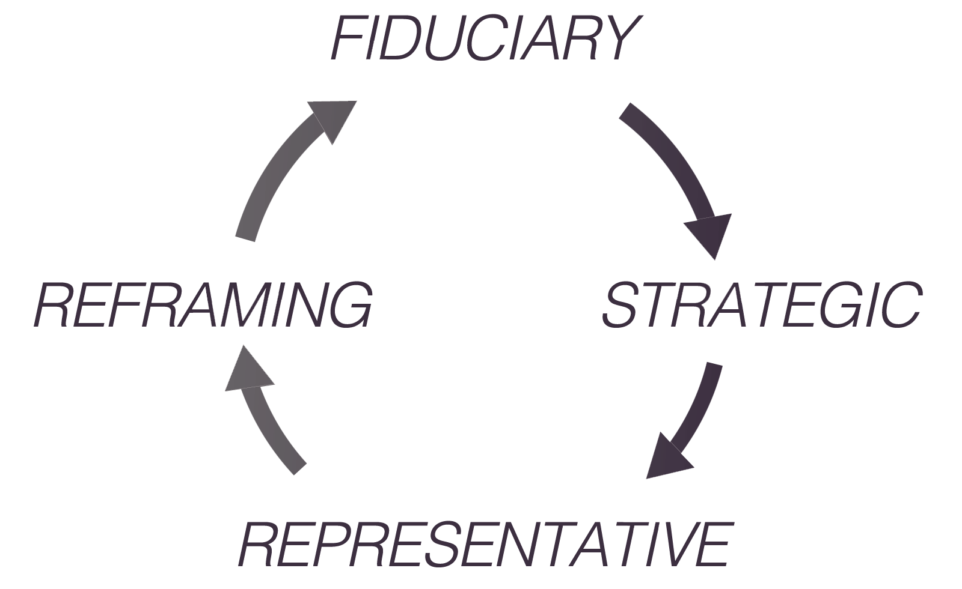
        Four Modes…

Slide 12
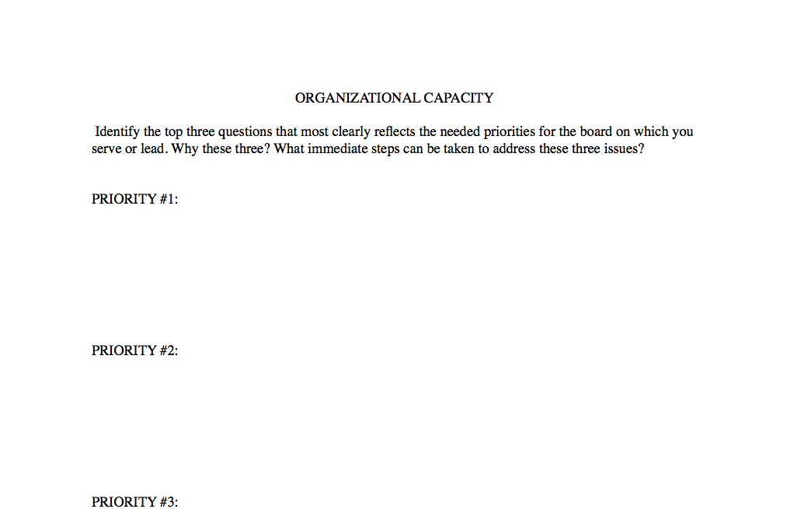
A Legal and Program Audit
Examples
See www.BoardServe.org. Click Blog. See February 24, 2015 blogpost

Slide 13
Board Responsibilities
The board has fiduciary, strategic and representative governance and reframing responsibilities for the organization in at least the areas of:
        1. Mission and vision clarity
        2. Strategic thinking and planning
        3. Financial health, oversight and budget approval
        4. Major gifts and capital development
        5. Mission implementation, strategy and review
        6. Problem-framing or “sense-making”
        7. Organizational connectivity and networking
        8. Property oversight, expansion, and legal standing

Slide 14
2
Non-negotiable
Ask the
"Right" questions.
Nurture a culture of asking mission-driven
and sustainability QUESTIONS

Slide 15
Questions such as:
What is the most critical issue or
major concern facing the board?
What legal documents need to
reviewed at least annually?
What three big ideas should the Board focus on for the next three years?
?

Slide 16
Who are we?
(What is our mission, vision, values?)
Where are we?
(Not a location on a map, but in the 'lifespan" of the organization)
Where are we going
(if we continue to do as we have done?)
?

Slide 17
Where could we go
(with a Spirit-inspired vision and a unified board?)
Why are we going "there?"
(What is our motivation for growth?)
How long will it take to get there?
(Spiritual, human, financial resources needed?)
How will we know when we get there?
?

Slide 18
What has changed significantly in the community to which the board must adjust, and make appropriate transitions?
?

Slide 19
What one thing,
if we do not attend
to this issue soon,
could create serious problems
for us in the near future?
What fresh
revenue-generating options
are available to us to
significantly increase revenue?
How can the MGRU model
for fund development
impact our organization?
?

Slide 20
Guard The Agenda!
Items for Information
Items for Discussion
Items for Decision

Slide 21
3
Non-negotiable
Communicate in conflict situations
with civility.
Collisions occur over vision, values, traditions, plans and …!
“Anchors are needed…!”

Slide 22
Speak Gracefully. Watch the words you speak.
Listen Intently. Seek first to understand.
Forgive Freely. Be proactive in extending forgiveness.

Slide 23
Care deeply. Value people, not power.
Plan Decisively. Combine clear vision and deep humility with intense resolve.
Focus on change in yourself
even as you seek for change in others.

Slide 24
Vigorously discuss policy options and make decisions within board meetings!
Communicate board action
outside of board meetings
with unified support!
Keep confidential conversations,
CONFIDENTIAL!
Accept board decisions...!
Fiercely guard a reliable word!

Slide 25
These values
CHARACTERIZE
us at our best, and they
CONVICT
us at our worst.

Slide 26
4
Embrace assessment
of prior board decisions
in light of present realities.
Review and Revise, as needed,
decision-making in shaping financial and
organizational development strategies

Slide 27

1. Understand your mission:
OVERARCHING
MISSION STATEMENT
4. Implement your plan:
COMPREHENSIVE
IMPLEMENTATION
PLAN
Continually review
and revise your strategy:
REVIEW AND REVISE
2. Assess your situation:
SITUATION
ASSESSMENT
3. Develop your goals:
PERSONAL/
PROFESSIONAL
GROWTH GOALS

Slide 28
Final
Non-negotiable
Connect Board Decision-making
to Capacity Building and
Organizational Sustainability
Map a compelling
CASE FOR SUPPORT
through forward-looking board policies

Slide 29
Board members take the lead in both giving and shaping the strategy to successfully complete a major gifts
fund raising initiative.

Slide 30
Nonprofit organizations
are in two businesses:
1. Providing services,
2. Generating revenue
necessary to provide
the services.

Slide 31
Both are needed:
STRONG BOARDS who EMPOWER MISSIONAL AND VISIONARY LEADERS;
STRONG LEADERS who EMBRACE PASSIONATE AND ENGAGED BOARDS!

Slide 32
TOGETHER,
THE ORGANIZATION MOVES
FROM VISION,
TO ACTION,
TO RESULTS!

Slide 33
This is a high performance governing board!

Slide 34

12 CHARACTERISTICS OF
Strong and Effective Boards

Slide 35
copyright pending by Boardserve LLC
Edward LeBron Fairbanks.
lfairbanks@boardserve.org
740.398.7184
Used by permission

